Slide 1
Update progress 2025/06/09 By: Krit Ittisomboon (クリット イティソンブーン) (Hymn) (ヒム)

Slide 2
Progress
Change the map to detailed version.
Enhanced Flight Radar
Real Weather Integration

Slide 3
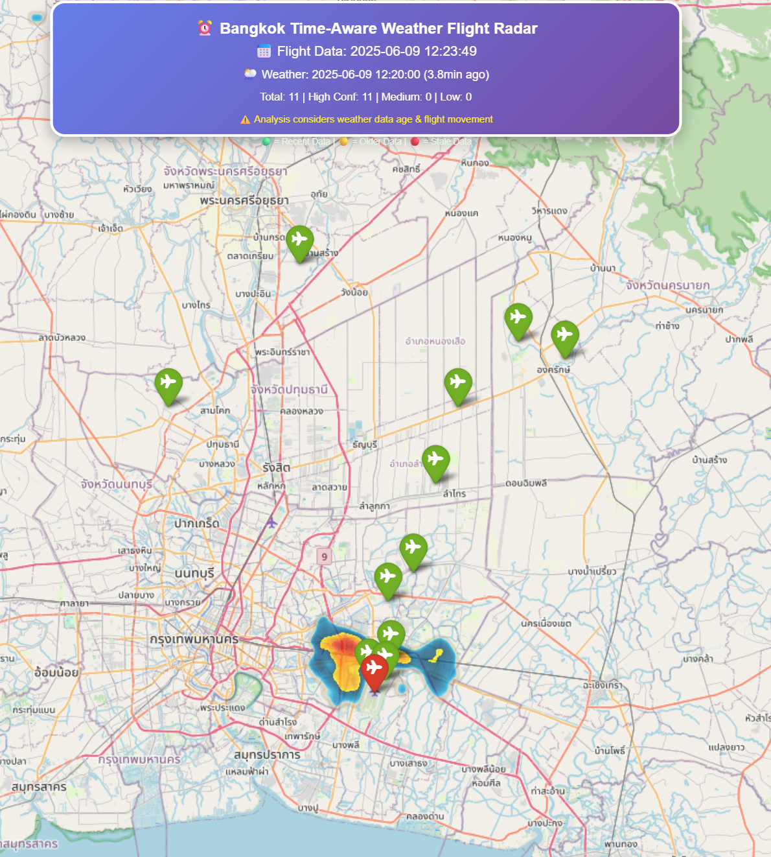
Result
A professional flight weather radar system that matches your existing radar's style while providing accurate, time-aware weather analysis. The system honestly reports data confidence and avoids the false weather readings you originally observed.

Slide 4
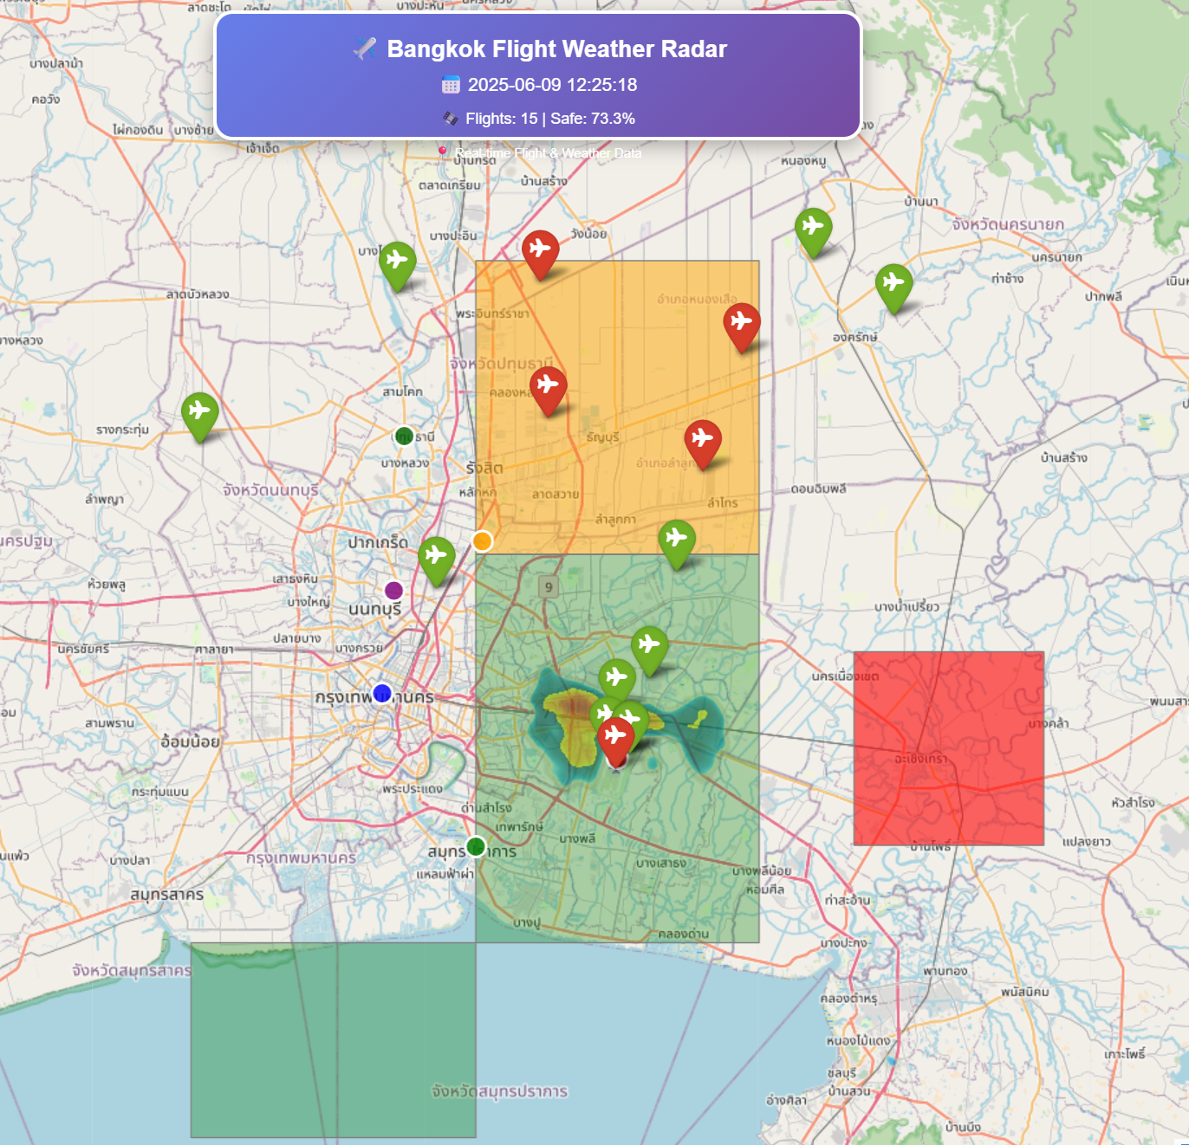
Problem
First version I create doesn’t show accurate map so I fix it to be more accurate.

Slide 5
Future work
Continue to do and gather data.
Echo Impact Analysis on Bangkok Airspace
Analyzing the current state of air traffic in and around Bangkok to identify current issues.

